Slide 1
2 Corinthians 1:12 - 2:11

Slide 2
¹² For our boast is this, the testimony of our conscience, that we behaved in the world with simplicity and godly sincerity, not by earthly wisdom but by the grace of God, and supremely so toward you. ¹³ For we are not writing to you anything other than what you read and understand and I hope you will fully understand — ¹⁴ just as you did partially understand us — that on the day of our Lord Jesus you will boast of us as we will boast of you.
¹⁵ Because I was sure of this, I wanted to come to you first, so that you might have a second experience of grace. ¹⁶ I wanted to visit you on my way to Macedonia, and to come back to you from Macedonia and have you send me on my way to Judea.

Slide 3
¹⁷ Was I vacillating when I wanted to do this? Do I make my plans according to the flesh, ready to say “Yes, yes” and “No, no” at the same time? ¹⁸ As surely as God is faithful, our word to you has not been Yes and No. That is why it is through him that we utter our Amen to God for his glory. ²¹ And it is God who establishes us with you in Christ, and has anointed us, ²² and who has also put his seal on us and given us his Spirit in our hearts as a guarantee.
²³ But I call God to witness against me — it was to spare you that I refrained from coming again to Corinth. ²⁴ Not that we lord it over your faith, but we work with you for your joy, for you stand firm in your faith.

Slide 4
2 For I made up my mind not to make another painful visit to you. ² For if I cause you pain, who is there to make me glad but the one whom I have pained? ³ And I wrote as I did, so that when I came I might not suffer pain from those who should have made me rejoice, for I felt sure of all of you, that my joy would be the joy of you all. ⁴ For I wrote to you out of much affliction and anguish of heart and with many tears, not to cause you pain but to let you know the abundant love that I have for you.

Slide 5
⁵ Now if anyone has caused pain, he has caused it not to me, but in some measure — not to put it too severely — to all of you. ⁶ For such a one, this punishment by the majority is enough, ⁷ so you should rather turn to forgive and comfort him, or he may be overwhelmed by excessive sorrow. ⁸ So I beg you to reaffirm your love for him. ⁹ For this is why I wrote, that I might test you and know whether you are obedient in everything. ¹⁰ Anyone whom you forgive, I also forgive. Indeed, what I have forgiven, if I have forgiven anything, has been for your sake in the presence of Christ, ¹¹ so that we would not be outwitted by Satan; for we are not ignorant of his designs.

Slide 6
Visits | Paul’s Letters | Other
First Visit
 | “Previous Letter”
 |  | Report to Paul
 |  | Letter to Paul
Timothy visits Corinth
 | 1 Corinthians
The Painful Visit
 | “The Severe Letter”
 |  | “Proposed” Visits don’t happen
 |  | Paul gets good report from Titus
 |  | “super-apostles” challenge Paul’s Authority
 | 2 Corinthians
3rd Visit

Slide 7
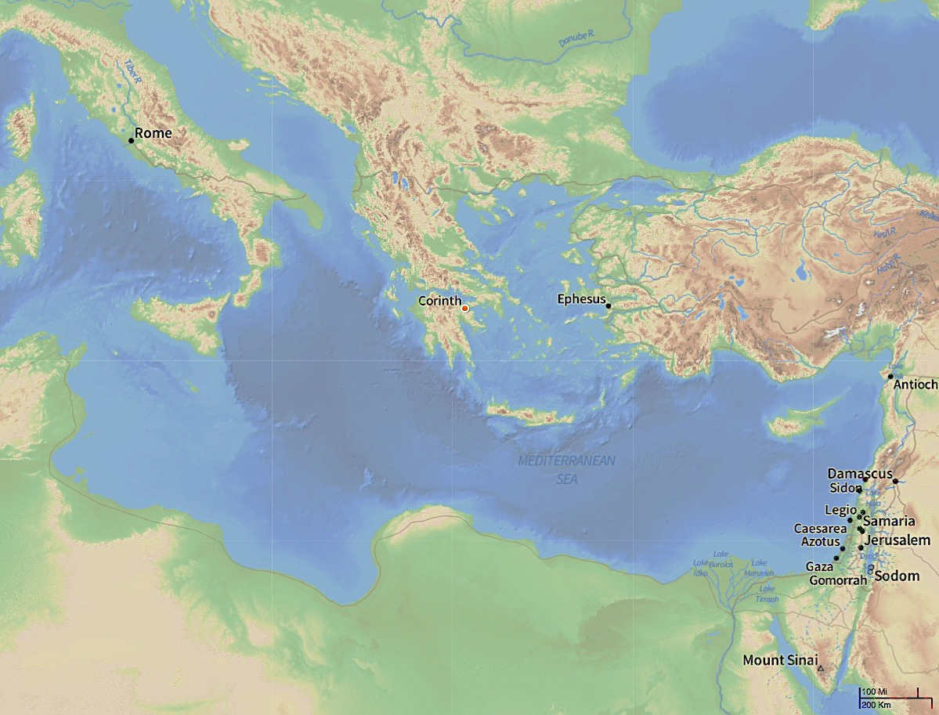
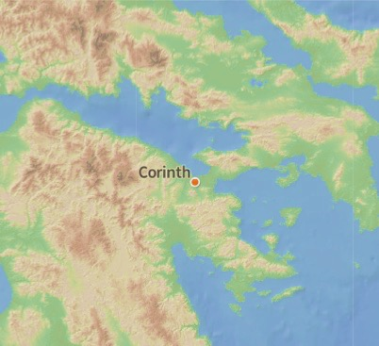

Slide 8
Visits | Paul’s Letters | Other
First Visit
 | “Previous Letter”
 |  | Report to Paul
 |  | Letter to Paul
Timothy visits Corinth
 | 1 Corinthians
The Painful Visit
 | “The Severe Letter”
 |  | “Proposed” Visits don’t happen
 |  | Paul gets good report from Titus
 |  | “super-apostles” challenge Paul’s Authority
 | 2 Corinthians
3rd Visit

Slide 9
False apostles infiltrated the church. They tried to discredit Paul.
Used Paul’s change of itinerary as evidence that Paul couldn’t be trusted
Paul examined his actions and his conscience was completely clear.

Slide 10
Jeremiah 9:²³ Thus says YHWH: “Let not the wise man boast in his wisdom, let not the mighty man boast in his might, let not the rich man boast in his riches, ²⁴ but let him who boasts boast in this, that he understands and knows me, that I am YHWH who practices steadfast love, justice, and righteousness in the earth. For in these things I delight, declares YHWH.”

Slide 11
False apostles infiltrated the church. They tried to discredit Paul.
Used Paul’s change of itinerary as evidence that Paul couldn’t be trusted
Paul examined his actions and his conscience was completely clear.
Godly boasting is publicly rejoicing in the righteousness of God that we undeservedly receive in Christ...
To boast in the church, is to boast in having a shared experience of Grace
The essence of Paul’s response to petty accusations: “Just as God is faithful, so am I”
^{23....} it was to spare you that I refrained from coming again to Corinth.
⁴ For I wrote to you out of much affliction and anguish of heart and with many tears, not to cause you pain but to let you know the abundant love that I have for you.
Another visit would cause unnecessary pain. Anything said taken as offence

Slide 12
¹⁷ Was I vacillating when I wanted to do this? Do I make my plans according to the flesh, ready to say “Yes, yes” and “No, no” at the same time? ¹⁸ As surely as God is faithful, our word to you has not been Yes and No. ¹⁹ For the Son of God, Jesus Christ, whom we proclaimed among you, Silvanus and Timothy and I, was not Yes and No, but in him it is always Yes. ²⁰ For all the promises of God find their Yes in him. That is why it is through him that we utter our Amen to God for his glory. ²¹ And it is God who establishes us with you in Christ, and has anointed us, ²² and who has also put his seal on us and given us his Spirit in our hearts as a guarantee.
Jesus always says “Yes” to God’s grand design. Obedience glorifies God
“Obedience to God” means we may have to put our own plans aside

Slide 13
The essence of Paul’s response to petty accusations: “Just as God is faithful, so am I”
Another visit would cause unnecessary pain. Anything said taken as offence
Jesus always says “Yes” to God’s grand design. Obedience glorifies God
“Obedience to God” means we may have to put our own plans aside
Paul’s concern: The church to be the reconciling community of Christ
Probable situation in Corinthian church (from indicators in 1Cor & 2Cor):
arch-antagonists Out-of-town “super-apostles”
a few people (and one in particular) convinced by them and attacked Paul
Majority of church not convinced by “super-apostles”. Loyal to the Gospel
With Paul’s encouragement, Loyal disciples took action against antagonists
The local antagonist repented
The “super-apostles” did not
The Church of Jesus Christ has to be a reconciling community
1. Confront false teaching and wrong behaviour
3. Repentance of sin
5. reconciliation and restoration
2. Sorrow & remorse for sin
4. Forgiveness

